Slide 1
PROFESSOR VELAZQUEZ
INTRODUCTION
TO
MICROECONOMICS
MODULE 04 · MARKET ANALYSIS: ELASTICITY AND EFFICIENCY
FALL 2025

Slide 2
04
Market Analysis:
Elasticity & Efficiency
Section I measures how responsive buyers and sellers are to price. Section II uses surplus to judge whether a market outcome is efficient. Section III joins the two: elasticity determines who actually bears the burden of a tax.
MODULE

Slide 3
MODULE 4
Agenda, Big Questions & Do Now
BIG QUESTIONS
PRE-WORK
WHAT YOU'LL NEED
(1) How responsive are buyers and sellers to price changes — and what factors determine the magnitude of that response?
(2) Under what conditions does a competitive market maximize aggregate well-being — and how do price controls distort that outcome?
(3) Who bears the burden of a tax or a government intervention — and how does elasticity influence the answer?
· Read Chapters 5–8 (Elasticity; Consumers, Producers and the Efficiency of Markets; Application: the Costs of Taxation)
· Complete the Module 4 Vocabulary Checklist
· Khan Academy: Elasticity — reach mastery
· Bring the Module 4 Worksheet, calculator and graph paper
· Module 4 Worksheet (printed)
· A calculator — today is the most computational day of the semester
· Graph paper for eight labeled diagrams
· Your Module 3 equilibrium notes
DO NOW · OPENING INQUIRY
A new gas tax of $0.50 per gallon is imposed. Does it raise revenue? Does it change how much gas people buy? Your answer depends entirely on how RESPONSIVE consumers and producers are to price changes — that is, on ELASTICITY.
AGENDA — DAY 1 · ELASTICITY | TIME | AGENDA — DAY 2 · EFFICIENCY & INCIDENCE | TIME
Do Now + the elasticity formula | 10 min | Do Now: whose burden? | 5 min
Part 1 — PED, classification, total revenue rule | 30 min | Part 4 — CS, PS, total surplus, the invisible hand | 25 min
Part 2 — Midpoint, income and cross-price elasticity | 20 min | Part 5 — Price controls and deadweight loss | 25 min
Part 3 — PES and its determinants | 15 min | Part 6 — Tax incidence: the synthesis | 20 min
INTRO TO MICROECONOMICS | PROF. VELAZQUEZ
MODULE 4: MARKET ANALYSIS — ELASTICITY & EFFICIENCY

Slide 4
BEFORE WE BEGIN
Vocabulary Checklist — Module 4
Price Elasticity of Demand (PED)
Elastic
Inelastic
Unit Elastic
Perfectly Elastic / Inelastic
Total Revenue Rule
Income Elasticity
Cross-Price Elasticity
Midpoint Method
Price Elasticity of Supply (PES)
Consumer Surplus (CS)
Producer Surplus (PS)
Total Surplus (TS)
Welfare Economics
Invisible Hand
Price Floor
Price Ceiling
Binding vs. Non-Binding
Deadweight Loss (DWL)
Willingness to Pay / Sell
Tax Incidence
Tax Burden Sharing
Statutory Incidence
Economic Incidence
Tax Wedge
MODULE 4 SYNTHESIS — READ THIS BEFORE CLASS
Elasticity and welfare analysis are not two separate tools. They must be deployed SIMULTANEOUSLY to answer the incidence question. Elasticity reveals who bears more; surplus analysis reveals how taxation divides total welfare and generates deadweight loss.
INTRO TO MICROECONOMICS | PROF. VELAZQUEZ
MODULE 4: MARKET ANALYSIS — ELASTICITY & EFFICIENCY

Slide 5
SECTION I
Elasticity
Part 1 · Price elasticity of demand: the formula, the five classifications, and the total revenue rule
Part 2 · The midpoint method; income elasticity and cross-price elasticity
Part 3 · Price elasticity of supply; time horizons and the determinants of PES

Slide 6
01
Price Elasticity
of Demand
PART
OBJECTIVE Compute PED (εd = %ΔQd / %ΔP); classify elastic, inelastic and unit elastic demand; interpret graphically and in terms of the total revenue rule.
INTRO TO MICROECONOMICS | PROF. VELAZQUEZ
MODULE 4: MARKET ANALYSIS — ELASTICITY & EFFICIENCY

Slide 7
PART 1 · THE FORMULA
What Elasticity Measures — and Why Percentages
εd = % Δ Quantity Demanded ÷ % Δ Price
PED measures the RESPONSIVENESS of quantity demanded to a change in the good's own price — how far buyers move when the price moves.
By the law of demand the numerator and denominator always have OPPOSITE signs, so εd is always NEGATIVE. We usually discuss its ABSOLUTE VALUE.
WHY PERCENTAGES, NOT UNITS?
ELASTICITY ≠ SLOPE
READING THE NUMBER
Because a slope depends on units. "Quantity falls by 3" means nothing without knowing whether that is 3 grams or 3 tons, or whether the starting quantity was 5 or 5 million. Percentage change is UNIT-FREE, so elasticities of different goods can be compared directly.
A straight demand line has a CONSTANT slope but a CHANGING elasticity — elastic near the top, unit elastic at the midpoint, inelastic near the bottom. This is because elasticity depends on the ratio P/Q as well as on the slope.
εd = (ΔQ/ΔP) × (P/Q).
|εd| > 1 → ELASTIC. Quantity responds MORE than proportionately. Buyers are sensitive.
|εd| < 1 → INELASTIC. Quantity responds LESS than proportionately. Buyers are insensitive.
|εd| = 1 → UNIT ELASTIC. Exactly proportionate.
THE FOUR DETERMINANTS OF PED
1. AVAILABILITY OF CLOSE SUBSTITUTES — the more substitutes, the MORE elastic. This is the master determinant; the other three are versions of it.
2. NECESSITIES vs. LUXURIES — necessities are INELASTIC (you buy them anyway); luxuries are ELASTIC (you can defer or forgo them).
3. NARROWLY vs. BROADLY DEFINED MARKETS — "food" is inelastic; "Honeycrisp apples at this stall" is highly elastic, because narrower definitions have more substitutes.
4. SHORT RUN vs. LONG RUN — demand is MORE elastic in the long run, because substitutes and adjustments take time to find (the 1973 oil shock, Module 3).
INTRO TO MICROECONOMICS | PROF. VELAZQUEZ
MODULE 4: MARKET ANALYSIS — ELASTICITY & EFFICIENCY

Slide 8
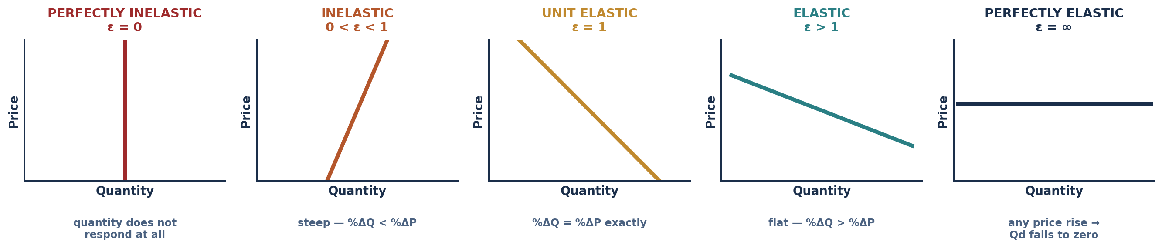
PART 1 · THE FIVE CLASSIFICATIONS
The Elasticity Spectrum
CLASSIFICATION | VALUE | MEANING | REAL-WORLD EXAMPLE
Perfectly inelastic | εd = 0 | Quantity demanded does not change at all when price changes. The curve is VERTICAL. | Insulin for a Type 1 diabetic; a life-saving antivenom; land (on the supply side).
Inelastic | 0 < |εd| < 1 | Quantity changes proportionately LESS than price. The curve is relatively STEEP. | Bread and other subsistence staples; gasoline in the short run; salt; utilities.
Unit elastic | |εd| = 1 | Quantity changes exactly in proportion to price. Total revenue is unchanged. | The midpoint of any linear demand curve; some broad consumer categories.
Elastic | |εd| > 1 | Quantity changes proportionately MORE than price. The curve is relatively FLAT. | Silk scarves and luxury imports; restaurant meals; a specific brand of cereal.
Perfectly elastic | |εd| = ∞ | Any price rise sends quantity demanded to zero. The curve is HORIZONTAL. | An individual wheat farmer's output in a perfectly competitive market (Module 10).
INTRO TO MICROECONOMICS | PROF. VELAZQUEZ
MODULE 4: MARKET ANALYSIS — ELASTICITY & EFFICIENCY

Slide 9
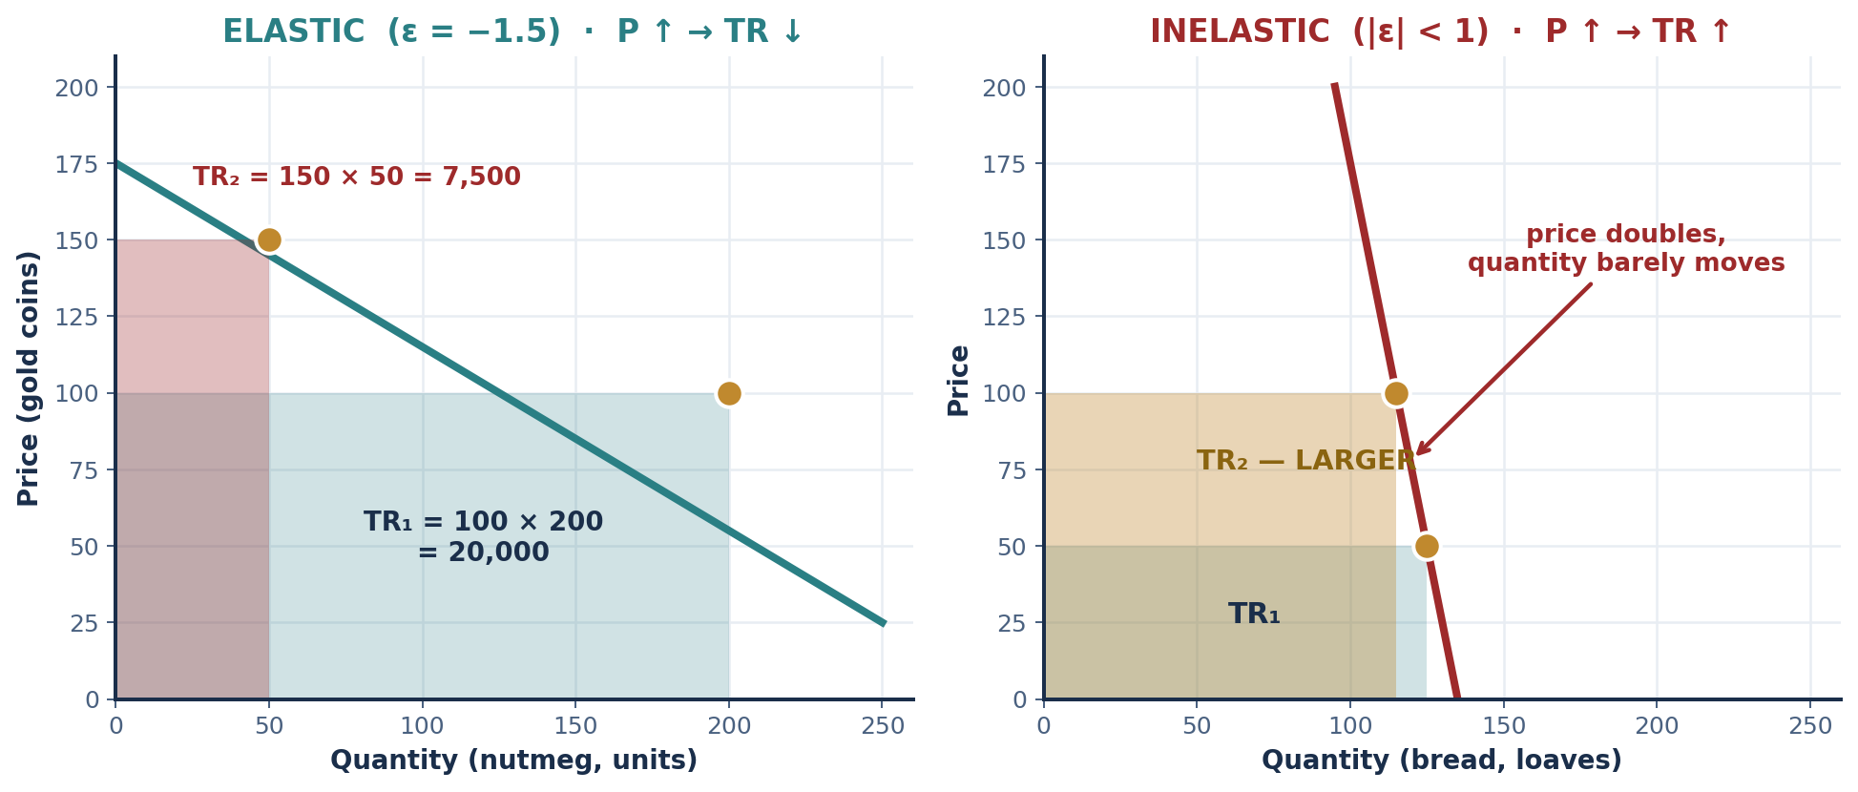
SCENARIO 4.1 · MELAKA STRAITS, C. 1460 CE
Nutmeg from the Banda Islands
The Banda Islands were the world's SOLE source of nutmeg. When the Melaka Sultanate imposed a tariff, price rose 50% and quantity demanded fell 75%.
εd = −75% ÷ +50% = −1.5
CLASSIFICATION: ELASTIC (|εd| = 1.5 > 1)
 | PRICE | QUANTITY | TOTAL REVENUE = P × Q
Before the tariff | 100 | 200 | 20,000
After the tariff | 150 | 50 | 7,500
Change | +50% | −75% | −12,500 (TR FELL)
THE TOTAL REVENUE RULE
TR = Market Price × Market Quantity. (This is NOT profit — we are not thinking about costs yet.)
ELASTIC (|ε| > 1): P ↑ → TR ↓. P and TR move in OPPOSITE directions, because the percentage fall in Q swamps the percentage rise in P.
INELASTIC (|ε| < 1): P ↑ → TR ↑. P and TR move in the SAME direction, because Q barely responds.
UNIT ELASTIC: TR is unchanged.
WHY IS DEMAND ELASTIC HERE?
Nutmeg was a LUXURY, not a necessity — a status spice for European and Asian elites who could simply buy less, or substitute cloves, pepper, or mace. Monopoly over supply does NOT make demand inelastic; those are different sides of the market.
INTRO TO MICROECONOMICS | PROF. VELAZQUEZ
MODULE 4: MARKET ANALYSIS — ELASTICITY & EFFICIENCY

Slide 10
PART 1 · CLASSIFICATION PRACTICE
Applying PED to Five Goods
GOOD OR SERVICE | PED CLASSIFICATION | ECONOMIC RATIONALE | EFFECT ON TR OF A PRICE INCREASE
Insulin (life-sustaining medication) | Perfectly inelastic / highly inelastic (|εd| ≈ 0) | No substitute exists; the good is a medical necessity and the alternative to purchase is death. Quantity demanded is essentially fixed. | TR RISES almost proportionately with price — which is precisely why insulin pricing is a policy flashpoint.
Silk scarves (luxury import) | Elastic (|εd| > 1) | A luxury with many substitutes — wool, linen, cotton, or simply going without. Purchase can be deferred indefinitely. | TR FALLS. Raising the price loses more revenue in lost sales than it gains per unit.
Bread (subsistence staple) | Inelastic (|εd| < 1) | A necessity with few close substitutes at the same cost per calorie. Households cut other spending before they cut bread. | TR RISES — the reason bread prices are politically explosive (Paris, 1791; see Part 5).
Marcus's neighborhood groceries | Inelastic in the short run; more elastic in the long run | Few nearby alternatives without a car or transit fare; travel cost is itself a barrier to substitution. Over time, a new store or a car changes this. | TR RISES in the short run. Note that low elasticity here reflects CONSTRAINT, not preference.
Ray's commercial storefronts (lease) | Inelastic on the supply side (fixed structures); demand inelastic where alternatives are scarce | A tenant with an established customer base, signage, and fit-out cannot relocate cheaply. Switching costs are a substitute-availability problem. | TR RISES for Ray. His pricing power comes from the tenant's low elasticity, not from any productivity of his own.
✦1 THE DISTRIBUTIONAL IMPLICATION
Necessities are inelastic; luxuries are elastic. A tax on STAPLE FOOD therefore falls almost entirely on buyers and raises stable revenue — and buyers of staples are disproportionately poor. A tax on LUXURIES is largely avoided by the buyer switching or abstaining, so it raises less revenue and falls partly on sellers. Efficiency and equity point in opposite directions here, which is precisely the politics of taxation.
INTRO TO MICROECONOMICS | PROF. VELAZQUEZ
MODULE 4: MARKET ANALYSIS — ELASTICITY & EFFICIENCY

Slide 11
02
The Midpoint Method,
Income & Cross-Price Elasticity
PART
OBJECTIVE Apply the midpoint method — the standard measure of arc elasticity; calculate income and cross-price elasticity; classify goods as normal or inferior, substitutes or complements.
INTRO TO MICROECONOMICS | PROF. VELAZQUEZ
MODULE 4: MARKET ANALYSIS — ELASTICITY & EFFICIENCY

Slide 12
PART 2 · ARC ELASTICITY
The Midpoint Method — and Why It Is Needed
εd = [ ( Q₂ − Q₁ ) ÷ ( (Q₁ + Q₂)/2 ) ] ÷ [ ( P₂ − P₁ ) ÷ ( (P₁ + P₂)/2 ) ]
The percentage change is computed against the MIDPOINT of the two values rather than the starting value.
THE PROBLEM IT SOLVES
ARC vs. POINT ELASTICITY
Ordinary percentage change is DIRECTION-DEPENDENT. Going from 100 to 140 is a 40% rise; going from 140 back to 100 is a 28.6% fall — the same movement gives two different elasticities depending on which end you start from.
Using the midpoint as the base makes the calculation SYMMETRIC: the same segment yields the same elasticity in either direction.
ARC elasticity measures responsiveness OVER A SEGMENT of the curve — the midpoint method. It is what you use with two data points.
POINT elasticity measures responsiveness AT A SINGLE POINT: εd = (dQ/dP)(P/Q). It requires calculus, and it is the honest definition — the midpoint method is its practical approximation.
WORKED EXAMPLE — SCENARIO 4.2: THE PORTUGUESE SEA ROUTE TO THE INDIES, VENICE & LISBON C. 1505
Vasco da Gama's direct sea route undermined Venetian control of the spice trade, lowering the price of pepper from 80 to 60 gold coins. Venetian merchants recorded Qd rising from 100 to 140 units.
%ΔQ = (140 − 100) ÷ 120 = +33.3% %ΔP = (60 − 80) ÷ 70 = −28.6% εd = 33.3 ÷ (−28.6) = −1.17 → ELASTIC
TR before = 80 × 100 = 8,000. TR after = 60 × 140 = 8,400. TR ROSE — exactly as the total revenue rule predicts for an elastic good whose price FALLS.
INTRO TO MICROECONOMICS | PROF. VELAZQUEZ
MODULE 4: MARKET ANALYSIS — ELASTICITY & EFFICIENCY

Slide 13
PART 2 · THE OTHER TWO ELASTICITIES
Income Elasticity & Cross-Price Elasticity
ε_income = %ΔQd ÷ %Δ Income
ε_cross = %ΔQd of Good 2 ÷ %ΔPrice of Good 1
SIGN | CLASSIFICATION | RULE OF THUMB | HISTORICAL EXAMPLE
ε_income > 0 | NORMAL GOOD | POSITIVE income elasticity. Income ↑ → Qd ↑. If ε_income > 1 the good is additionally a LUXURY; between 0 and 1 it is a necessity. | Spices, silk and porcelain in the early modern Indian Ocean trade — consumption rose faster than merchant incomes.
ε_income < 0 | INFERIOR GOOD | NEGATIVE income elasticity. Income ↑ → Qd ↓. The relationship is INVERSE. | Barley bread in medieval Europe: as wages rose after the Black Death, households substituted toward wheat bread.
ε_cross > 0 | SUBSTITUTES | POSITIVE cross-price elasticity. Goods used INSTEAD OF one another — a rise in Good 1's price raises demand for Good 2. | Indian cottons and European linens competing in the 17th-century textile market; tea and coffee in many settings.
ε_cross < 0 | COMPLEMENTS | NEGATIVE cross-price elasticity. Goods used TOGETHER — a rise in Good 1's price lowers demand for Good 2. | Sugar and coffee in Ottoman coffeehouses; gasoline and large cars; printers and ink.
THREE ELASTICITIES, ONE GRAMMAR
Every elasticity is a ratio of two percentage changes: the SIGN tells you the direction of the relationship, and the MAGNITUDE tells you its strength. PED is negative by the law of demand, so we discuss |εd|. Income and cross-price elasticities can take EITHER sign — and the sign is the whole classification.
INTRO TO MICROECONOMICS | PROF. VELAZQUEZ
MODULE 4: MARKET ANALYSIS — ELASTICITY & EFFICIENCY

Slide 14
SCENARIO 4.3 · SAFAVID PERSIA & OTTOMAN TRADE, C. 1685
An Isfahan Merchant's Household Accounts
Istanbul's coffeehouses were the social centers of the Ottoman Empire. Sugar and coffee were consumed together; Indian cottons and European linens competed in textiles. An Isfahan craftsman household recorded income and trade data across two decades.
READING THE CROSS-PRICE RESULT
The computed value is NEGATIVE, which by definition classifies tea and coffee as COMPLEMENTS in this household: when tea became dearer, they drank LESS coffee, not more.
That is the opposite of the usual textbook expectation, and it is worth pausing on. In the Ottoman coffeehouse the two were consumed as part of a single social ritual alongside sugar — so a price rise in one input contracted the whole occasion. Classification follows the SIGN OF THE DATA, not the label we expect.
YEAR | HOUSEHOLD INCOME (ducats) | Qd OF SPICES | PRICE OF TEA (Good 1) | Qd OF COFFEE (Good 2)
Year 1 | 100 | 50 | 20 | 30
Year 2 | 150 | 80 | 30 | 18
% change | +50% | +60% | +50% | −40%
WHY THIS MATTERS METHODOLOGICALLY
TASK 1: ε_income = +60% ÷ +50% = +1.2
Substitutes and complements are not intrinsic properties of goods. They are properties of a RELATIONSHIP measured in a particular market, for a particular population, at a particular time. The same two goods can be substitutes in one setting and complements in another.
POSITIVE → a NORMAL good. And because ε_income > 1, spices are additionally a LUXURY:
consumption rose FASTER than income.
TASK 2: ε_cross = −40% ÷ +50% = −0.8
CHECK YOUR WORKSHEET
If your worksheet narrative describes tea and coffee as substitutes but your computed elasticity is negative, TRUST THE COMPUTATION and say so in your answer. Explaining why the data disagrees with the expectation is a better answer than forcing the data to fit.
INTRO TO MICROECONOMICS | PROF. VELAZQUEZ
MODULE 4: MARKET ANALYSIS — ELASTICITY & EFFICIENCY

Slide 15
03
Price Elasticity of Supply
& Its Determinants
PART
OBJECTIVE Compute PES = %ΔQs / %ΔP; connect time horizons to supply elasticity; enumerate the determinants of PES.
INTRO TO MICROECONOMICS | PROF. VELAZQUEZ
MODULE 4: MARKET ANALYSIS — ELASTICITY & EFFICIENCY

Slide 16
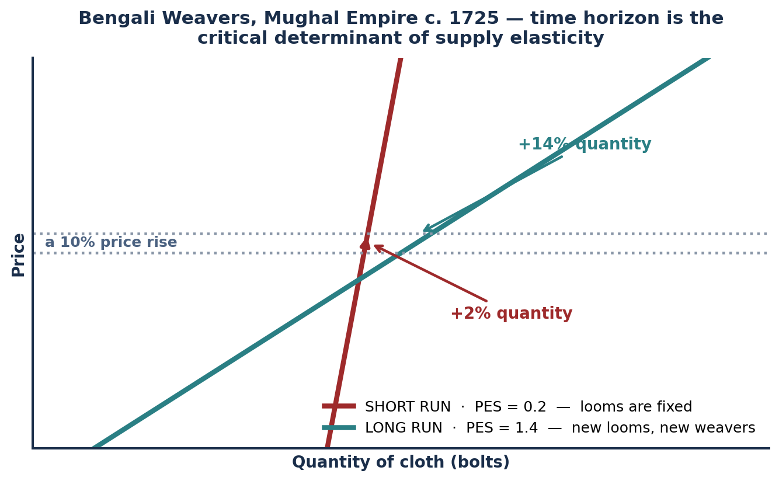
SCENARIO 4.4 · BENGAL, MUGHAL EMPIRE, C. 1725
Bengali Weavers — Time Horizon and Supply Elasticity
PES = %ΔQs ÷ %ΔP
THE TWO FIGURES INTERPRETED
SHORT RUN, PES = 0.2: a 10% price increase expands quantity supplied by only 0.2 × 10% = 2%. Looms are FIXED; weavers can work longer hours, and little else.
LONG RUN, PES = 1.4: the SAME 10% price increase expands quantity supplied by 1.4 × 10% = 14%. New looms can be built and new weavers trained.
WHY THE TIME HORIZON IS DECISIVE
Because FIXED FACTORS OF PRODUCTION cannot be varied within the short run — by definition (Module 1). Supply elasticity is therefore not a fact about a good; it is a fact about a good AND a time horizon.
DETERMINANT OF PES | INCREASES ELASTICITY | REDUCES ELASTICITY
Time horizon | Long run | Short run
Inventory & storage capacity | Large, cheap storage | Perishable, no storage
Factor mobility | Inputs move easily between uses | Highly specialized inputs
Spare productive capacity | Idle plant available | Already at full capacity
SECONDARY DETERMINANT — CAPACITY
Even with strong price incentives, output is bounded by available productive capacity: raw fiber, workshop space, skilled hands. A producer already at full capacity has PES near zero regardless of price.
INTRO TO MICROECONOMICS | PROF. VELAZQUEZ
MODULE 4: MARKET ANALYSIS — ELASTICITY & EFFICIENCY

Slide 17
PART 3 · WORKSHEET ✦2
The Special Case of Land — PES = 0
THE QUESTION
Land has a perfectly inelastic supply (PES = 0). What does this imply about who bears the burden of a tax on land — the buyer or the seller? How does the incidence principle applied to land help explain why a land value tax might be unusually efficient?
1
THE QUANTITY CANNOT RESPOND
2
THE LANDOWNER BEARS 100%
3
WHY THAT MAKES IT EFFICIENT
The supply of land is fixed by nature. No price, however high, produces more of it; no price, however low, produces less. Graphically the supply curve is VERTICAL.
This is the pure case of the perfectly inelastic classification from Part 1 — applied to supply rather than demand.
By the incidence formula (Part 6), the seller's share is |PED| / (PES + |PED|). With PES = 0 that fraction equals 1: the SELLER bears the ENTIRE burden.
The tax is capitalized into a lower land price. The owner cannot pass it forward, because they cannot withdraw supply in response.
Deadweight loss arises from TRADES THAT DO NOT HAPPEN because the tax discouraged them. If quantity cannot change, no trades are discouraged — so the DWL triangle has zero base.
A land value tax raises revenue with ZERO deadweight loss. This is Henry George's argument (1879), and Ricardo's theory of rent underneath it.
PES = 0 → DWL = ½ × 0 × height = 0
Every other tax distorts quantity. A tax on a perfectly inelastic base does not. Keep this result — it is the sharpest single illustration that elasticity and efficiency are the same subject.
INTRO TO MICROECONOMICS | PROF. VELAZQUEZ
MODULE 4: MARKET ANALYSIS — ELASTICITY & EFFICIENCY

Slide 18
SECTION II
Welfare Analysis & Market Efficiency
Part 4 · Consumer surplus, producer surplus, total surplus, and the invisible hand theorem
Part 5 · Binding price floors and ceilings; computing deadweight loss
Part 6 · Tax incidence — the synthesis of elasticity and welfare analysis

Slide 19
04
Consumer Surplus, Producer Surplus
& the Invisible Hand
PART
OBJECTIVE Derive total surplus (TS = CS + PS); explain the invisible hand theorem; calculate CS and PS geometrically.
INTRO TO MICROECONOMICS | PROF. VELAZQUEZ
MODULE 4: MARKET ANALYSIS — ELASTICITY & EFFICIENCY

Slide 20
PART 4 · WELFARE ECONOMICS
Reading Demand and Supply as Valuations
CONSUMER SURPLUS (CS)
PRODUCER SURPLUS (PS)
DEFINITION: the benefit a consumer receives from engaging in the market.
In WELFARE ECONOMICS, the demand curve is read as the consumer's WILLINGNESS TO PAY — the maximum each buyer would have given up for each unit.
CS = Willingness to Pay − Price Actually Paid (summed over all units purchased)
RULE OF THUMB: a LOWER price → HIGHER consumer surplus.
GRAPHICALLY: the area BELOW the demand curve and ABOVE the market price.
DEFINITION: the benefit a producer receives from engaging in the market.
In WELFARE ECONOMICS, the supply curve is read as the producer's WILLINGNESS TO SELL — the minimum each seller would have accepted for each unit, which is that unit's marginal cost.
PS = Price Actually Received − Willingness to Sell (summed over all units sold)
RULE OF THUMB: a HIGHER price → HIGHER producer surplus.
GRAPHICALLY: the area ABOVE the supply curve and BELOW the market price.
TOTAL SURPLUS = CS + PS
Equivalently: TS = (value to buyers) − (cost to sellers). Total surplus is the total gain from trade the market generates.
THE INVISIBLE HAND THEOREM — AND ITS THREE ASSUMPTIONS
In a competitive market, the equilibrium quantity MAXIMIZES total surplus. Below Q*, some buyer values a unit more than it costs to produce — a mutually beneficial trade is going unmade. Above Q*, some unit costs more to produce than any buyer values it. Only at Q* is neither true.
The theorem holds ONLY IF: (1) markets are perfectly competitive; (2) there are no externalities — no costs or benefits fall on non-parties; (3) information is complete and symmetric. Modules 10, 11 and 12 are, in order, the removal of each assumption.
INTRO TO MICROECONOMICS | PROF. VELAZQUEZ
MODULE 4: MARKET ANALYSIS — ELASTICITY & EFFICIENCY

Slide 21
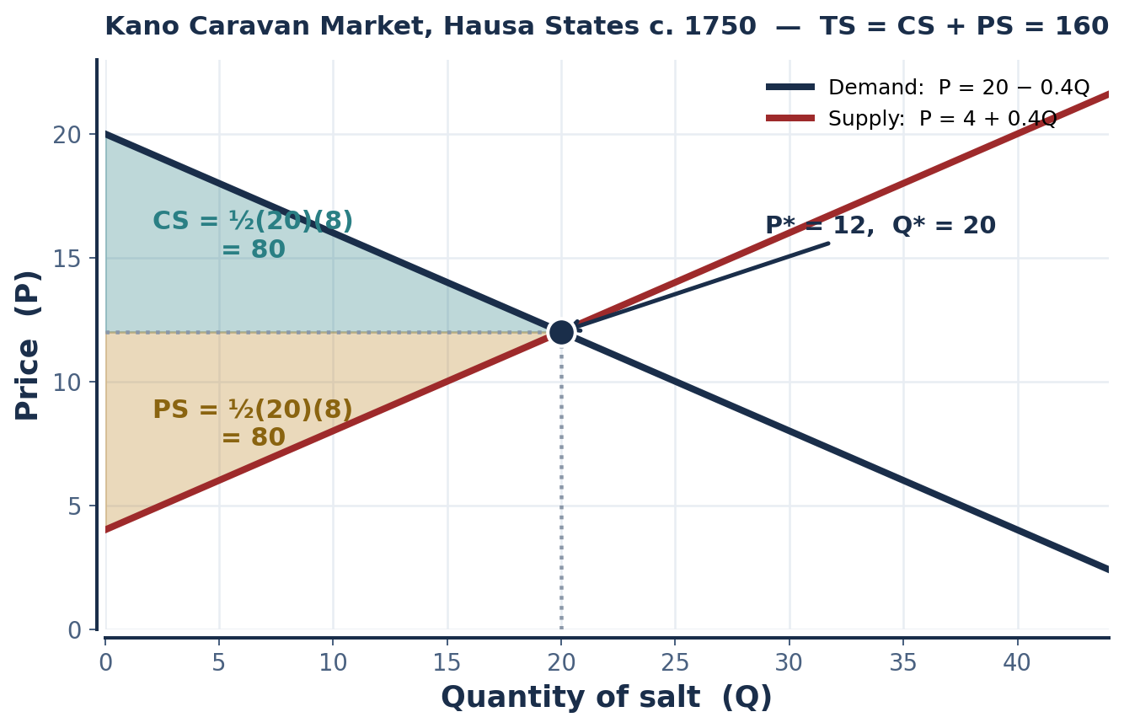
SCENARIO 4.5 · KANO, HAUSA STATES, C. 1750
The Kano Caravan Market — Computing Surplus
A salt market operating under Islamic commercial law. Compute the equilibrium, derive CS and PS, and evaluate the market's efficiency claim.
Demand: P = 20 − 0.4Q Supply: P = 4 + 0.4Q
20 − 0.4Q = 4 + 0.4Q
16 = 0.8Q → Q* = 20
P* = 20 − 0.4(20) = 12
CHECK: 4 + 0.4(20) = 12 ✓
MEASURE | GEOMETRY | VALUE
Consumer surplus | ½ × base × height = ½ × 20 × (20 − 12) | 80
Producer surplus | ½ × base × height = ½ × 20 × (12 − 4) | 80
Total surplus | CS + PS | 160
WHY THE TWO ARE EQUAL HERE
Because the demand and supply slopes are symmetric (−0.4 and +0.4). Change either slope and the split changes — the relative ELASTICITIES determine who captures the surplus.
INTRO TO MICROECONOMICS | PROF. VELAZQUEZ
MODULE 4: MARKET ANALYSIS — ELASTICITY & EFFICIENCY

Slide 22
PART 4 · WORKSHEET ✦3
Efficient — and Possibly Unjust
THE QUESTION
The invisible hand theorem holds that free markets maximize total surplus — but it says nothing about DISTRIBUTION. In what sense is a competitive equilibrium "efficient," and in what sense might it nonetheless be deeply unjust? Who is left out of the total surplus calculation?
1
THE PRECISE SENSE OF 'EFFICIENT'
2
WHO IS LEFT OUT
3
THE DEEPER POINT
ALLOCATIVE EFFICIENCY: no reallocation could make one person better off without making another worse off (Pareto). Equivalently: every trade whose value exceeds its cost happens, and no trade whose cost exceeds its value happens.
That is ALL the theorem claims. It is a statement about the SIZE of total surplus, and about nothing else.
· Anyone whose willingness to pay is limited by INABILITY to pay — need does not appear in a demand curve.
· NON-PARTIES who bear costs or receive benefits from the transaction: externalities (Module 12).
· FUTURE PEOPLE, whose valuations are absent from a present-day market.
· Anyone excluded by discrimination, distance or information (Module 8).
Total surplus is measured in DOLLARS, and a dollar of surplus counts the same whoever holds it. That accounting choice is itself a normative judgment — it weights the wealthy buyer's marginal dollar exactly as heavily as the poor buyer's.
Efficiency is a real and useful criterion. It is not the only one, and it is not neutral.
A market can CLEAR, be EFFICIENT, and still leave people hungry.
All three statements can be true at once, and none of them contradicts the others. Keeping them apart — positive from normative, Module 1 — is the discipline this course is trying to teach.
INTRO TO MICROECONOMICS | PROF. VELAZQUEZ
MODULE 4: MARKET ANALYSIS — ELASTICITY & EFFICIENCY

Slide 23
05
Government Intervention:
Price Controls & Deadweight Loss
PART
OBJECTIVE Analyze binding price controls (floors and ceilings); compute deadweight loss; evaluate the equity-efficiency trade-off.
INTRO TO MICROECONOMICS | PROF. VELAZQUEZ
MODULE 4: MARKET ANALYSIS — ELASTICITY & EFFICIENCY

Slide 24
PART 5 · THE COMPARISON
Price Floors vs. Price Ceilings
FEATURE | PRICE FLOOR | PRICE CEILING
To be BINDING, it must be set… | ABOVE the equilibrium price | BELOW the equilibrium price
Intended to help… | PRODUCERS / SELLERS | CONSUMERS / BUYERS
It creates a… | SURPLUS (excess supply) | SHORTAGE (excess demand)
Quantities when binding | Qs > Qd | Qd > Qs
Quantity actually traded | Qd — the SHORT side of the market | Qs — the SHORT side of the market
Historical example | Philadelphia Wheat Floor, 1794 | Paris Bread Cap (maximum de prix), 1791
Effect on efficiency | Creates waste; unsold surpluses pile up; resources are drawn into overproduction | Creates unmet demand; queues, rationing, quality decline and black markets emerge
THE BRAIN MISTAKE | It sits ABOVE equilibrium on the graph but it is a MINIMUM price — the price may not go below it. | It sits BELOW equilibrium on the graph but it is a MAXIMUM price — the price may not go above it.
DEADWEIGHT LOSS (DWL) — FORMAL DEFINITION
The loss in TOTAL SURPLUS that occurs when a market is NOT at equilibrium. It represents MUTUALLY BENEFICIAL TRADES THAT NEVER HAPPEN.
DWL = ½ × base × height, where BASE = Q* − Q actually traded, and HEIGHT = the vertical gap between the demand and supply curves at the traded quantity.
KEY INSIGHT: when a market operates away from equilibrium, some consumers who value the good MORE than it costs to produce are simply not served. Those lost trades are the 'deadweight' — value that existed and was destroyed by nobody's gain.
INTRO TO MICROECONOMICS | PROF. VELAZQUEZ
MODULE 4: MARKET ANALYSIS — ELASTICITY & EFFICIENCY

Slide 25
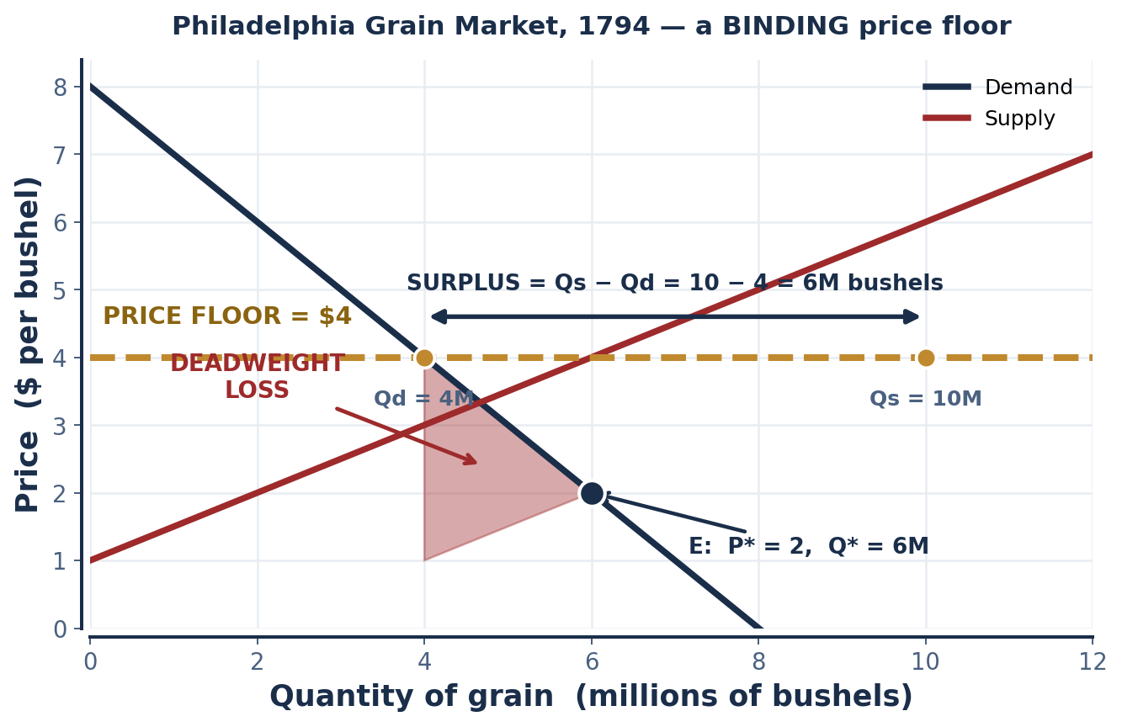
SCENARIO 4.6 · UNITED STATES, 1794
The Philadelphia Grain Market — A Binding Price Floor
During Whiskey Rebellion political pressures, the government imposed a price floor of $4 per bushel on grain. Competitive equilibrium: P* = $2, Q* = 6M bushels. At the floor: Qs = 10M, Qd = 4M.
QUESTION | ANSWER
Is the floor binding? | YES — $4 exceeds P* = $2. A floor binds only when set above equilibrium.
Surplus created | Qs − Qd = 10M − 4M = 6M bushels of unsold grain
Quantity traded | 4M — the SHORT side (Qd). Sellers cannot force buyers to purchase.
DWL base | Q* − Q traded = 6M − 4M = 2M bushels
DWL height | $4 − $2 = $2 per bushel (worksheet method)
DEADWEIGHT LOSS | ½ × 2M × $2 = $2 million
WHO IS HARMED, WHO BENEFITS
BENEFIT: producers who still sell — they receive $4 instead of $2. HARMED: consumers, who pay more and get less; and producers who cannot find a buyer among the 6M unsold bushels. Taxpayers too, if the government buys the surplus.
NOTE ON THE DWL HEIGHT
The worksheet uses height = P_floor − P*. The FULL deadweight triangle actually spans from the supply curve to the demand curve at the traded quantity — here $4 − $1 = $3, giving $3M. Use the worksheet method on the worksheet; know the exact construction for the exam.
INTRO TO MICROECONOMICS | PROF. VELAZQUEZ
MODULE 4: MARKET ANALYSIS — ELASTICITY & EFFICIENCY

Slide 26
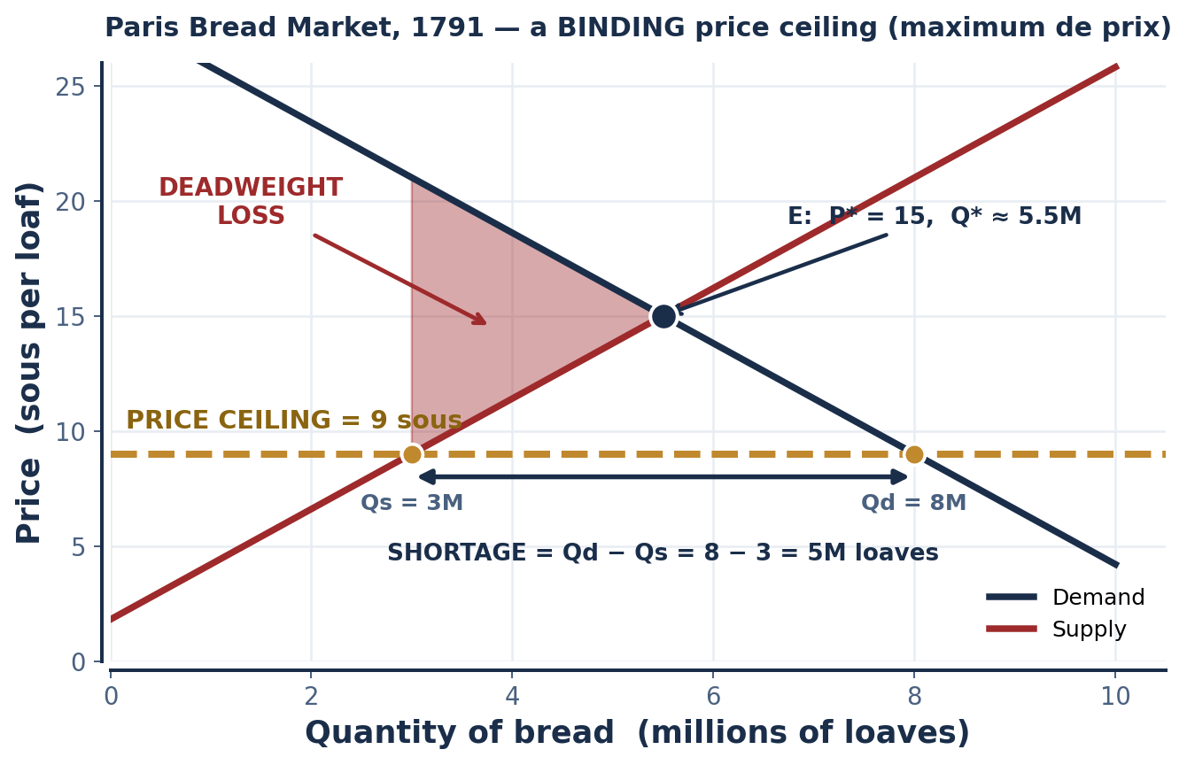
SCENARIO 4.7 · FRANCE, 1791
The Paris Bread Market — A Binding Price Ceiling
The National Assembly imposed a price ceiling — the maximum de prix — on bread at 9 sous per loaf; the competitive equilibrium price was 15 sous. At the ceiling: Qd = 8M loaves, Qs = 3M loaves.
QUESTION | ANSWER
Is the ceiling binding? | YES — 9 sous is below P* = 15 sous. A ceiling binds only when set below equilibrium.
Shortage created | Qd − Qs = 8M − 3M = 5M loaves of unmet demand
Quantity traded | 3M — the SHORT side (Qs). Buyers cannot force sellers to bake.
DWL base | Q* − Q traded ≈ 5.5M − 3M = 2.5M loaves
DWL height | the vertical gap between demand and supply at Q = 3M ≈ 21 − 9 = 12 sous
DEADWEIGHT LOSS | ½ × 2.5M × 12 ≈ 15M sous of destroyed surplus
WHY THE BREAD RIOTS BROKE OUT
Not because bread was expensive — the law had made it cheap. Because at 9 sous there was NOT ENOUGH BREAD. A binding ceiling converts a price problem into an AVAILABILITY problem, and rationing then happens by queue, by connection, by violence, or by black market rather than by price.
READING THE NUMBERS
Q* is not given in the scenario; it must be read off your graph. The figures above assume symmetric linear curves through (15, Q*) — state your assumption when you show your work.
INTRO TO MICROECONOMICS | PROF. VELAZQUEZ
MODULE 4: MARKET ANALYSIS — ELASTICITY & EFFICIENCY

Slide 27
PART 5 · WORKSHEET ✦4
When Might a Price Ceiling Be Justified?
THE QUESTION
Price ceilings are frequently enacted to protect low-income consumers from rising prices. Yet standard welfare analysis shows they generate shortages and deadweight loss. Under what specific conditions might a price ceiling be justified — and what supplementary policies might reduce the efficiency cost while preserving the equity objective?
1
WHEN A CEILING IS DEFENSIBLE
2
WHAT THE MODEL PREDICTS
3
SUPPLEMENTARY POLICIES
· When SUPPLY IS HIGHLY INELASTIC in the relevant horizon — then the quantity distortion, and so the DWL, is small (recall PES = 0 → DWL = 0).
· When the seller has MARKET POWER, so the pre-control price already exceeded marginal cost (Modules 10–11).
· When the good is a NECESSITY and the alternative to a ceiling is destitution rather than substitution.
· As a TEMPORARY measure during an acute shock, where the alternative is a price spike on a captive population.
· A SHORTAGE, with rationing by queue, connection, or black market.
· QUALITY DEGRADATION — sellers cut quality when they cannot cut price.
· REDUCED INVESTMENT in supply over the long run, making the shortage worse the longer the control lasts.
· A DISTRIBUTIONAL LOTTERY: the people who get the good are not necessarily the people the policy meant to help.
· INCOME TRANSFERS or targeted vouchers instead of price controls — help the buyer, not the price. This preserves the price signal.
· SUBSIDIES TO SUPPLY, which shift S right and lower price without creating a shortage.
· PUBLIC PROVISION or buffer stocks.
· SUNSET CLAUSES that limit the long-run investment damage.
The general principle: intervene in the BUDGET CONSTRAINT rather than in the PRICE.
Efficiency loss is a COST, not a veto.
A policy with deadweight loss can still be the right policy if it buys enough of some other objective. The economist's job is to make the cost VISIBLE and to look for a cheaper way to buy the same equity —
not to declare the equity objective illegitimate. That is precisely the positive / normative boundary from Module 1.
INTRO TO MICROECONOMICS | PROF. VELAZQUEZ
MODULE 4: MARKET ANALYSIS — ELASTICITY & EFFICIENCY

Slide 28
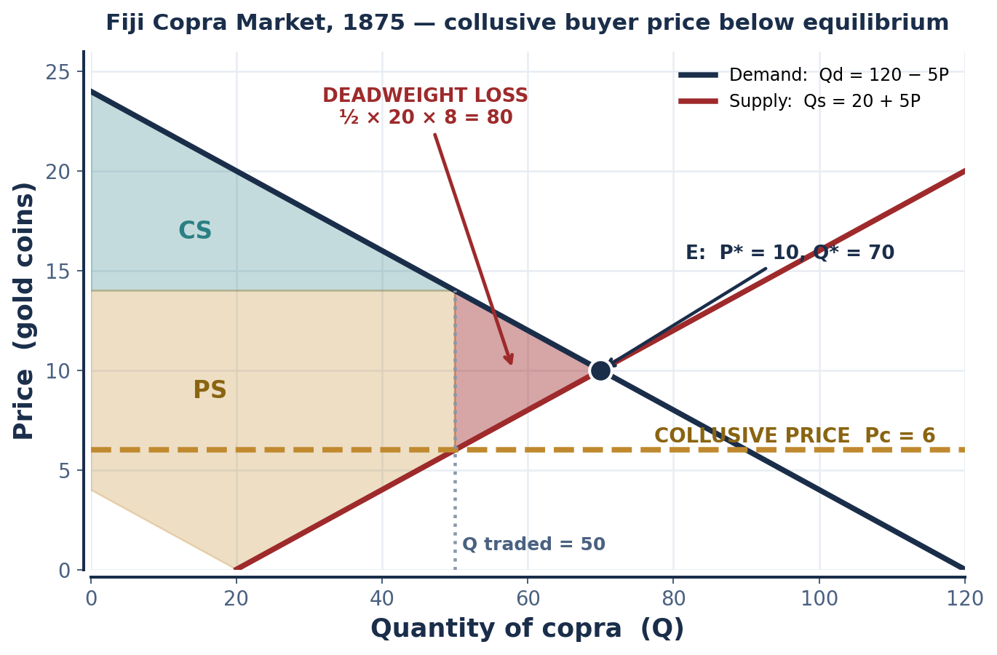
SCENARIO 4.8 · FIJI, 1875
The Fiji Copra Market — Collusion Below Equilibrium
European traders colluded to hold copra purchase prices artificially low at Pc = 6 gold coins, below equilibrium. Demand: Qd = 120 − 5P. Supply: Qs = 20 + 5P.
120 − 5P = 20 + 5P
100 = 10P → P* = 10, Q* = 70
TASK | COMPUTATION | RESULT
Qd at Pc = 6 | 120 − 5(6) | 90
Qs at Pc = 6 | 20 + 5(6) | 50
Quantity actually traded | the SHORT side — supply restricts output | 50
DWL base | Q* − Q traded = 70 − 50 | 20
DWL height (exact) | demand price − supply price at Q = 50: 14 − 6 | 8
DEADWEIGHT LOSS | ½ × 20 × 8 | 80
IN WHICH DIRECTION DID THE DWL SHIFT CS AND PS?
Away from Fijian PRODUCERS and toward European BUYERS. The colluding traders captured part of what had been producer surplus as a transfer; the remainder — the triangle — was destroyed outright.
INTRO TO MICROECONOMICS | PROF. VELAZQUEZ
MODULE 4: MARKET ANALYSIS — ELASTICITY & EFFICIENCY

Slide 29
SECTION III
Tax Incidence — the Synthesis
Part 6 · The incidence principle: the more inelastic side of the market bears the larger share of the burden
Part 6 · Statutory vs. economic incidence — why they diverge, and why it does not matter who writes the check
Part 6 · Application to the Ottoman spice tax and to Marcus & Ray's payroll tax

Slide 30
06
Tax Incidence:
Elasticity Determines Who Pays
PART
OBJECTIVE Apply the tax incidence principle — the more inelastic side bears more of the burden — and distinguish statutory from economic incidence.
INTRO TO MICROECONOMICS | PROF. VELAZQUEZ
MODULE 4: MARKET ANALYSIS — ELASTICITY & EFFICIENCY

Slide 31
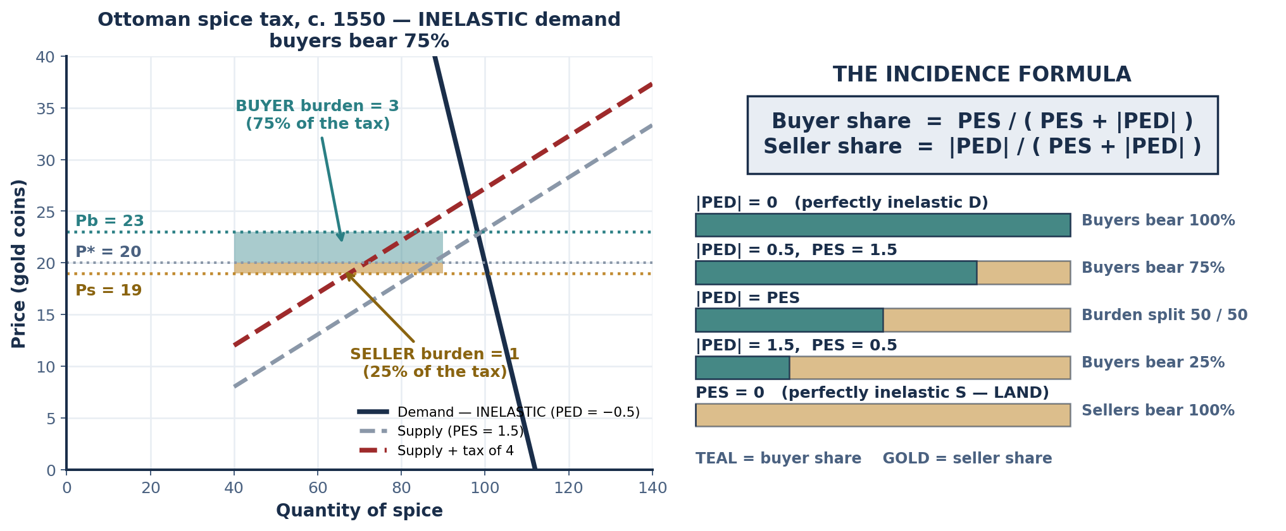
PART 6 · THE CORE PRINCIPLE
Who Actually Pays a Tax?
Buyer's share = PES / ( PES + |PED| ) Seller's share = |PED| / ( PES + |PED| )
THE MORE INELASTIC SIDE OF THE MARKET BEARS THE LARGER SHARE OF THE BURDEN.
This holds regardless of who is legally required to remit the tax to the government.
THE INTUITION IN ONE SENTENCE
The side that CAN walk away — the elastic side — does walk away, so the side that CANNOT walk away ends up holding the bill.
INTRO TO MICROECONOMICS | PROF. VELAZQUEZ
MODULE 4: MARKET ANALYSIS — ELASTICITY & EFFICIENCY

Slide 32
SCENARIO 4.9 · OTTOMAN EMPIRE, C. 1550
The Ottoman Tax on Spice Merchants
A per-unit tax of 4 gold coins is imposed on the spice market. Demand PED = −0.5 (inelastic); Supply PES = 1.5 (elastic). Pre-tax equilibrium: P* = 20, Q* = 100 units.
READING THE DIAGRAM
Buyer share = 1.5 / (1.5 + 0.5) = 0.75
Seller share = 0.5 / (1.5 + 0.5) = 0.25
The tax drives a WEDGE between the price buyers pay and the price sellers receive. Graphically, the supply curve shifts UP by the full amount of the tax.
The new equilibrium quantity is LOWER than Q* — and that quantity reduction is exactly where the deadweight loss comes from. Total tax revenue is the rectangle (tax × new quantity); the DWL is the triangle to its right.
Notice that the government collects the same revenue no matter which side remits it.
QUANTITY | COMPUTATION | RESULT
Price paid by buyers, Pb | 20 + 0.75(4) | 23
Price received by sellers, Ps | 20 − 0.25(4) | 19
Buyer burden | Pb − P* = 23 − 20 | 3 (75%)
Seller burden | P* − Ps = 20 − 19 | 1 (25%)
The tax wedge | Pb − Ps = 23 − 19 | 4 ✓ equals the tax
THE THREE QUANTITIES TO KEEP STRAIGHT
Pb — the price BUYERS pay, which RISES.
Ps — the price SELLERS receive, which FALLS.
Pb − Ps — the TAX WEDGE, which always equals the full per-unit tax.
Burden is measured from P*, not from each other: buyer burden = Pb − P*, seller burden = P* − Ps. The two burdens always sum to the tax.
WHY THE INELASTIC SIDE BEARS MORE
Buyers of spice have few substitutes and reduce purchases very little when price rises, so sellers can pass most of the tax forward. Sellers, being elastic, would cut output sharply if they absorbed it — so they do not have to.
INTRO TO MICROECONOMICS | PROF. VELAZQUEZ
MODULE 4: MARKET ANALYSIS — ELASTICITY & EFFICIENCY

Slide 33
SCENARIO 4.10 · PHILADELPHIA, PRESENT DAY
Marcus & Ray — The Payroll Tax
The city imposes a $2/hour payroll tax on employers in Marcus's industry. Labor DEMAND is relatively inelastic (firms need workers regardless of wage); labor SUPPLY is relatively elastic (workers can relocate or switch industries).
STATUTORY INCIDENCE
ECONOMIC INCIDENCE
THE GENERAL RULE, AND THE USUAL CASE
Falls on the EMPLOYER. That is what the statute says: the employer remits the $2 per hour to the city.
Statutory incidence is a legal fact. It is decided by legislation, and it is the thing people argue about in public.
Falls on whichever side is MORE INELASTIC. In this scenario, labor DEMAND is the inelastic side — so the EMPLOYER bears more of this particular tax.
Economic incidence is an economic fact. It is decided by elasticities, and legislation cannot change it.
MORE INELASTIC SIDE = LARGER BURDEN.
Empirically, labor SUPPLY is often the more inelastic side — most people cannot easily stop working or move cities. That is why real-world payroll taxes "on employers" are largely passed to workers as lower wages. This scenario reverses the usual elasticities to make the principle, not the memorized answer, do the work.
✦5 EXPLAINING IT TO MARCUS IN PLAIN LANGUAGE
"The company writes the check, but it decides what to pay you AFTER accounting for that check. If you and everyone like you would keep working here anyway, the company can quietly hold your wage $2 lower and you have no way to push back. If instead you could all walk across the river tomorrow for the same job, the company has to eat the $2 itself or lose you."
If Marcus's labor supply were PERFECTLY INELASTIC (PES = 0), he would bear 100% of the tax.
INTRO TO MICROECONOMICS | PROF. VELAZQUEZ
MODULE 4: MARKET ANALYSIS — ELASTICITY & EFFICIENCY

Slide 34
YOU TRY
Module 4 — Independent Practice
Complete all six Parts of the Module 4 Worksheet, including every calculation and all eight labeled diagrams.
Khan Academy: Elasticity — price elasticity of demand, total revenue, income and cross-price elasticity, elasticity of supply. Reach mastery.
Khan Academy: Consumer and Producer Surplus, Market Interventions and Deadweight Loss.
Answer reflection questions ✦1 through ✦5 in complete sentences — each one asks you to convert a calculation into an argument.
HOMEWORK RULE OF THUMB: above 80% → move on. Below 80% → retry once or twice. Consistently below 80% → office hours, immediately.
20
MIN
INTRO TO MICROECONOMICS | PROF. VELAZQUEZ

Slide 35
MODULE 4
What You Should Be Able to Do
 | LEARNING OUTCOME
Part 1 | Compute PED and state its sign; classify a result into the five categories; name the four determinants and predict elasticity from a description of a good; state and apply the total revenue rule in both directions.
Part 2 | Apply the midpoint method and explain why it is preferred to simple percentage change; compute income and cross-price elasticity; classify goods as normal, inferior, luxury, substitute or complement FROM THE SIGN OF THE DATA.
Part 3 | Compute PES and convert an elasticity into a predicted percentage quantity response; explain why the time horizon is the critical determinant; list four determinants of PES; explain the land case and why PES = 0 implies zero deadweight loss.
Part 4 | Define CS and PS in terms of willingness to pay and willingness to sell; compute both geometrically; state the invisible hand theorem WITH its three assumptions; articulate what efficiency does and does not establish.
Part 5 | Distinguish binding from non-binding controls; predict surplus or shortage; identify the short side of the market as the traded quantity; compute deadweight loss; evaluate the equity-efficiency trade-off of a price control and propose alternatives.
Part 6 | Apply the incidence formula; compute Pb, Ps, the tax wedge and each side's burden; distinguish statutory from economic incidence; explain in plain language why a tax 'on employers' can fall on workers, and state the condition for the reverse.
NEXT
MODULE 5 — FACTOR MARKETS. We turn the market model around: the households that were buyers become sellers of land, labor and capital, and the firms that were sellers become buyers. The tools are identical; the logic inverts.
INTRO TO MICROECONOMICS | PROF. VELAZQUEZ
MODULE 4: MARKET ANALYSIS — ELASTICITY & EFFICIENCY

Slide 36
MODULE 4
References
George, H. (1879). Progress and poverty. New York: D. Appleton.
Marshall, A. (1890). Principles of economics. London: Macmillan. (origin of the elasticity concept)
Mankiw, N. G. (2021). Principles of microeconomics (9th ed.), Chs. 5–8. Cengage.
Ricardo, D. (1817). On the principles of political economy and taxation. London: John Murray. (theory of rent)
Rothschild, E. (2001). Economic sentiments: Adam Smith, Condorcet, and the Enlightenment. Harvard University Press.
Bourke, H. (1988). The rise and fall of the Fiji copra trade. Journal of Pacific History.
Rudé, G. (1959). The crowd in the French Revolution. Oxford University Press. (the maximum de prix and the bread riots)
Loosley, E. (2005). The Isfahan bazaar and Safavid commerce. Iranian Studies.
Milburn, R. (2005). Nutmeg and the Banda Islands: The spice monopoly. Indonesia and the Malay World.
Prakash, O. (1998). European commercial enterprise in pre-colonial India. Cambridge University Press. (Bengali weavers)
INTRO TO MICROECONOMICS | PROF. VELAZQUEZ
MODULE 4: MARKET ANALYSIS — ELASTICITY & EFFICIENCY

